Slide 1
Introductory Data Science and Machine Learning
CP1407
Lecture #4
Supervised Learning - Classification

Slide 2
Lecture Overview
What is Classification?
Classification Process
Evaluation of Classification Models

Slide 3
Pre-Reading List
Pre-Lecture work (reading) for students:
Textbook 2 (Data Mining: Practical Machine Learning Tools and Applications) – Chapter 2, Chapter 3, Chapter 5
Han and Kamber (2012), “Data Mining: Concepts and Techniques” 3rd Edition. – Chapter 8 (Classification: Basic Concepts)

Slide 4
Classification
Classification: the process of labeling a set of objects in feature space
Samples in the same class form a contiguous region of space
Samples from different classes don’t overlap (much)
Notes:
Slide for body text

Slide 5

Feature Space
Each sample row is a point in feature space
Government
Science
Arts

Slide 6
k-Nearest Neighbour
To classify an instance d into class c:
Define a neighborhood of k nearest neighbors of d
Count number of instances that belong to c
Choose majority class as label

Slide 7
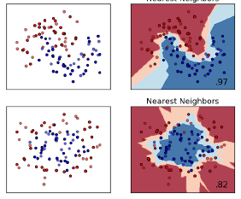
Example
Notes:
Slide for body text

Slide 8
Classification Process
Feature extraction
Feature selection
Classification
Algorithms
Training
Data
Document instance | class
Give your bank account and I give you 1 million | Spam email
Dear Prof Classifier, | Non-spam
Text Classification | Non-spam
Classifier
(Model)
spam
You bank password… | ?
Testing
Data
Feature extraction
Notes:
Slide for body text

Slide 9
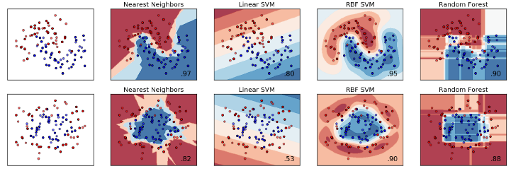
Types of Models
Data
k-NN
SVM
NN
Trees
Notes:
Slide for body text

Slide 10
Model Construction
Describe a set of predetermined classes
The set of tuples used for model construction: training set
The set of tuples used for model validation: test set
The model is represented as classification rules, decision trees, or mathematical formulae
Notes:
Slide for body text

Slide 11
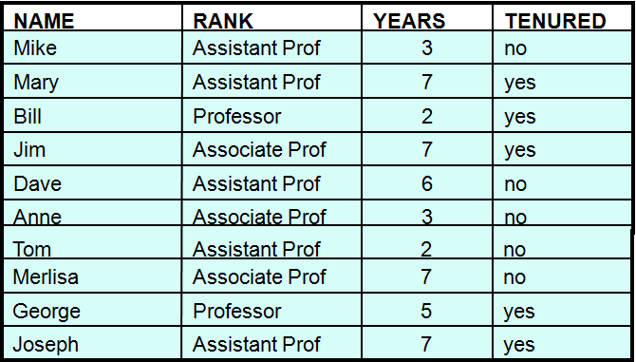
Dataset
Training Data
Test Data
Notes:
Slide for body text

Slide 12
Model Construction
Classification
Algorithms
Training
Data
Classifier
(Model)
IF rank = ‘professor’
OR years > 6
THEN tenured = ‘yes’

Slide 13
Model Usage
For classifying future or unknown objects
Estimate accuracy of the model
The known label of test sample is compared with the classified result from the model
Accuracy rate is the percentage of test set samples that are correctly classified by the model
Test set is independent of training set, otherwise over-fitting will occur
Notes:
Slide for body text

Slide 14
Measure accuracy
Testing
Data
Classifier
IF rank = ‘professor’
OR years > 6
THEN tenured = ‘yes’

Slide 15
Model Prediction
IF rank = ‘professor’
OR years > 6
THEN tenured = ‘yes’
Tenured?
Classifier
Unseen Data
(Jeff, Professor, 4)

Slide 16
k-Nearest Neighbour
To classify an instance d into class c:
Define a neighborhood of k nearest neighbors of d
Count number of instances that belong to c
Choose majority class as label

Slide 17
k-NN (k=6)
P(Government| )?
P(Science| )?
P(Arts| )?
Government
Science
Arts
Notes:
Slide for body text

Slide 18
Evaluation
Contingency table (or confusion table) shows various measures of how accurate your classifier is.
True Positive (TP) : Correctly indicates passing.
False Positive (FP) : Incorrectly indicates passing.
False Negative (FN) : Incorrectly indicates failure.
True Negative (TN) : Correctly indicates failure.
Classified class
Yes
No
Original class
Yes
TP
FN
No
FP
TN
Contingency table (2X2)
Notes:
Slide for body text

Slide 19
Accuracy
Classification Accuracy = (TP + TN) ‘
(TP + FP + FN + TN)
Classified class
Yes
No
Original class
Yes
TP
FN
No
FP
TN
Contingency table (2X2)
Proportion of correctly classified examples.
Notes:
Slide for body text

Slide 20
Sensitivity (Recall)
Sensitivity = TP ‘
(TP + FN)
Classified class
Yes
No
Original class
Yes
TP
FN
No
FP
TN
Contingency table (2X2)
Proportion of correctly detected positive examples.
Notes:
Slide for body text

Slide 21
Specificity
Specificity = TN ‘
(TN + FP)
Classified class
Yes
No
Original class
Yes
TP
FN
No
FP
TN
Contingency table (2X2)
Proportion of correctly detected negative examples.
Notes:
Slide for body text

Slide 22
Precision
Precision = TP ‘
(TP + FP)
Classified class
Yes
No
Original class
Yes
TP
FN
No
FP
TN
Contingency table (2X2)
Proportion of examples correctly detected as positive are indeed positive.
Notes:
Slide for body text

Slide 23
Sensitivity Example
If you want to find every person with a disease, use
Sensitivity = True Positive Rate = TP / (TP + FN)
This is because a false negative is very bad (disastrous).
The doctor says you don’t have cancer. Hooray!
Then you die of cancer because you didn’t get early treatment → that’s bad.
The FP tends to be very large.
Better that 100 healthy people get re-checked, than to let a single sick person go untreated.

Slide 24
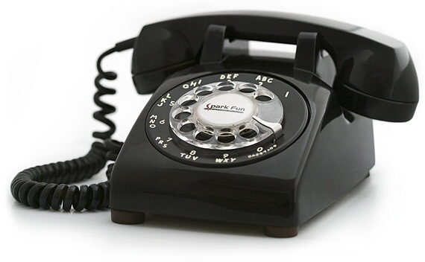
Precision Example
If you don’t want to find every person with a disease, but you want to avoid false positives, use
Precision = TP / (TP + FP)
Some true positive cases will be missed.
You only want to find some of the positive cases.
Popular in marketing problems.
Your database has millions of people, and we can’t phone all of them.
We want a classifier to find people, such that 99% of them will buy
→ Want low FP.

Slide 25
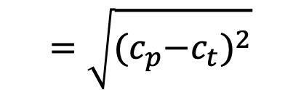
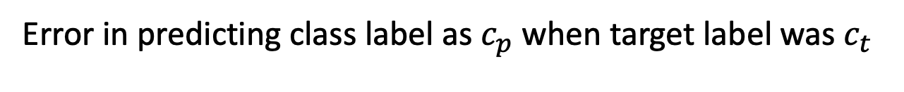
Error
Error in predicting class label as $c_{p}$ when target label was $c_{t}$
$$=\sqrt{{{(c}_{p}−c_{t})}^{2}}$$
Root Mean
Square Error
Notes:
Slide for body text

Slide 26
Summary
Classification learns the model from known samples.
Choice of evaluation metric is important.
Notes:
Slide for body text

